Slide 1
LRU vs MRU
CS448 Staff

Slide 2
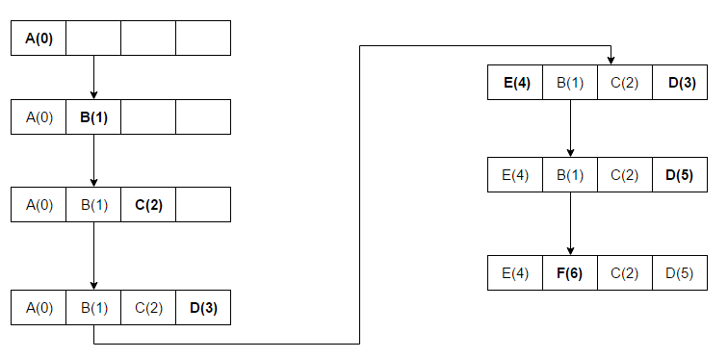
Least recently used (LRU)
Discards the least recently used items first.

Slide 3
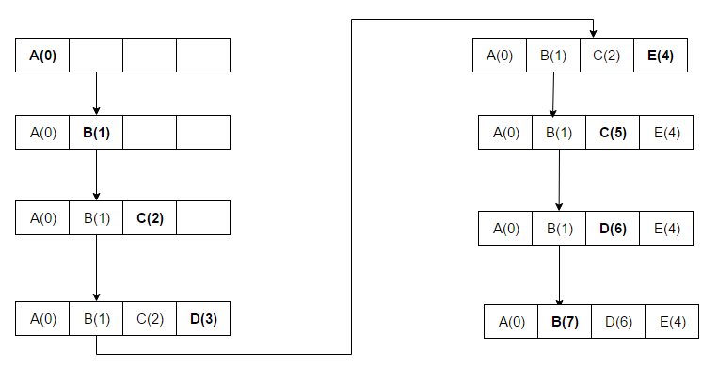
Most recently used (MRU)
Discards, in contrast to LRU, the most recently used items first.

Slide 4
Sequential flooding : Nasty situation caused by LRU + repeated sequential scans.
# frames < # pages in file.
Using LRU, every scan of the file will result in reading every page of the file.
Let us say there is 2 buffer frames Frame #1 and Frame #2, 3 pages in file P1, P2 and P3. What would happen if we scan the file twice(P1, P2, P3, P1, P2, P3) with sequential scan?

Slide 5
Sequential flooding (Continue) LRU
Block Read | Frame #1 | Frame #2
P1 | P1
P2 | P1 | P2
P3 | P3 | P2
P1 | P3 | P1
P2 | P2 | P1
P3 | P2 | P3
As you can see, using LRU, every scan of a page will cost a page miss. However, MRU will do much better.

Slide 6
Sequential flooding (Continue) MRU
Block Read | Frame #1 | Frame #2
P1 | P1
P2 | P1 | P2
P3 | P1 | P3
P1 | P1 (Page hit) | P3
P2 | P2 | P3
P3 | P2 | P3 (Page Hit)
Using MRU, We have two Page hits. In general, we can have #frame page hits in 2nd scan

Slide 7
Nested Join
Suppose we have two #frames. Join two files, and each of them has 3 pages
for each record A do
for each record of B do
If record match then output ...

Slide 8
Nested Join: Smarter - compare everything in the pages
Suppose we have two #frames. Join two files, and each of them has 3 pages
for each page PA of A do
for each page PB of B do
match the records in PA and PB ...

Slide 9
Join LRU
Clock | Block Read | Frame #1 | Frame #2 | Frame #3
0 | PA1 | PA1 (pinned) (0)
1 | PB1 | PA1 (pinned) (0) | PB1 (1)
2 | PB2 | PA1 (pinned) (0) | PB1 (1) | PB2 (2)
3 | PB3 | PA1 (pinned) (0) | PB3 (3) | PB2 (2)
4 |  | PA1 (unpinned) (4) | PB3 (3) | PB2 (2)
5 | PA2 | PA1 (4) | PB3 (3) | PA2 (5) (pinned)
6 | PB1 | PA1 (4) | PB1 (6) | PA2 (5) (pinned)
7 | PB2 | PB2 (7) | PB1 (6) | PA2 (5) (pinned)
8 | PB3 | PB2 (7) | PB3 (8) | PA2 (5) (pinned)
Unpin PA1, which is the most recently used page.

Slide 10
Join (Continue) LRU
Clock | Block Read | Frame #1 | Frame #2 | Frame #3
8 | PB3 | PB2 (7) | PB3 (8) | PA2 (5) (pinned)
9 |  | PB2 (7) | PB3 (8) | PA2 (9) (unpinned)
10 | PA3 | PA3 (10) (pinned) | PB3 (8) | PA2 (9)
11 | PB1 | PA3 (10) (pinned) | PB1 (11) | PA2 (9)
12 | PB2 | PA3 (10) (pinned) | PB1 (11) | PB2 (12)
13 | PB3 | PA3 (10) (pinned) | PB3 (13) | PB2 (12)
14 |  | PA3 (14) (unpinned) | PB3 (13) | PB2 (12)
Using LRU, every scan of a page will cost a page miss.so we need to re-read to get 2nd record - so IOs is #pages in A * #pages in B. However, MRU will do much better.

Slide 11
Join MRU
Clock | Block Read | Frame #1 | Frame #2 | Frame #3
0 | PA1 | PA1 (pinned) (0)
1 | PB1 | PA1 (pinned) (0) | PB1 (1)
2 | PB2 | PA1 (pinned) (0) | PB1 (1) | PB2 (2)
3 | PB3 | PA1 (pinned) (0) | PB1 (1) | PB3 (3)
4 |  | PA1 (unpinned) (4) | PB1 (1) | PB3 (3)
5 | PA2 | PA2 (5) | PB1 (1) | PB3 (3)
6 | PB1 | PA2 (5) (pinned) | PB1 (6) (page hit) | PB3 (3)
7 | PB2 | PA2 (5) (pinned) | PB2 (7) | PB3 (3)
8 | PB3 | PA2 (5) (pinned) | PB2 (7) | PB3 (8) (page hit)
Unpin PA1, which is the most recently used page.
Read PA2 to replace PA1.

Slide 12
Join (Continue) MRU
Clock | Block Read | Frame #1 | Frame #2 | Frame #3
8 | PB3 | PA2 (5) (pinned) | PB2 (7) | PB3 (8) (page hit)
9 |  | PA2 (9) (unpinned) | PB2 (7) | PB3 (8)
10 | PA3 | PA3 (10) (pinned) | PB2 (7) | PB3 (8)
11 | PB1 | PA3 (10) (pinned) | PB2 (7) | PB1 (11)
12 | PB2 | PA3 (10) (pinned) | PB2 (12) (page hit) | PB1 (11)
13 | PB3 | PA3 (10) (pinned) | PB3 (13) | PB1 (11)
14 |  | PA3 (14) (unpinned) | PB3 (13) | PB2 (11)
Using MRU, we have #frame -1 page hits in 2nd scan

Slide 13
More Discussion
MRU isn’t always better either
Example: Root vs. lower-level nodes of index, lots of pages
MRU keeps low-level from old searches, may discard root
LRU more likely to keep root

Slide 14
Want to know more, see
Hong-Tai Chou and David J. DeWitt. An Evaluation of Buffer Management Strategies for Relational Database Systems.
http://www.vldb.org/conf/1985/P127.PDF

Slide 15
Thank You!

